Slide 1
Data Preprocessing Project
By: Lauren Prather, Vibhor Sagar, Rachel Mao, Santiago Bermudez, Mueed Khalid, Marco Toro, Jared Rogue

Slide 2
Documenting or describing a comprehensive set of techniques for preprocessing.
Data quality issues: Data quality issues include missing values, duplicate data, noise, and outliers. These issues can affect the data for preprocessing and have an adverse effect on data mining.
Training and Validation: A machine learning model will learn from the training data and then be evaluated based on the validation data.
Aggregation: Data aggregation is a preprocessing task where the values of two or more objects are combined into a single object. The motivation for aggregation includes: Reducing the size of data to be processed. Changing the granularity of analysis (from fine-scale to coarser-scale). Improving the stability of the data.
Sampling: Sampling is an approach commonly used to facilitate Data reduction for exploratory data analysis and scaling up algorithms to big data applications. Quantifying uncertainties due to varying data distributions.
Discretization: Discretization is a data preprocessing step used to transform a continuous-valued attribute into a categorical attribute.
Binarization Attribute Transformation: This is a process where data is mapped with one or more binary variables.
Dimensionality reduction: When data increases along with sparsity, it takes more space to represent the data. This makes it more difficult to find outliers and makes it harder to cluster more relevant data. Dimensionality reduction helps with decreasing the sparsity of data, reducing the density of data, and helping with better visualization of data. One of the main techniques for dimensionality reduction is Principal Component Analysis (PCA).
Feature subset selection: Helps with the reduction of both duplicate data and dimensionality.
Feature creation: When preprocessing data, feature creation is helpful for creating new subcategories to capture more useful and important data.

Slide 3
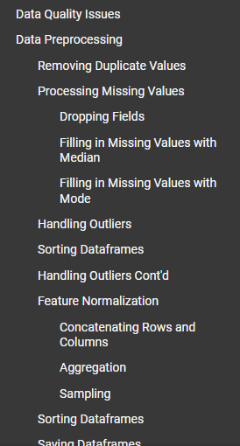
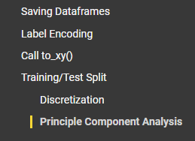
Showing all steps in proper order for preprocessing and why you think the order you used is important. 20%
The screenshots posted here show the order in which we did things for preprocessing.
When we worked on preprocessing, we felt that it would be necessary to deal with duplicates, missing values, and with unnecessary columns first because we felt it would save time and processing power for the later steps if we can make our data easier to understand and easier to work with. We then decided to get rid of certain outliers for the same reason (*although we split the dataframe into three groups). After that, we would combine the dataframes and then perform the rest of the steps, which we felt would benefit from being executed with a smaller and cleaner dataframe. This was how we determined the order in which to do things.

Slide 4
Developing and documenting human insights on preprocessed data and possible effect on predictions.
Data Quality Issues:
Missing Value: Sometimes raw values can be hidden, or not properly collected.
Inconsistent Data: Can also be known as Duplicate Data, where merging data sources takes place.
Noisy Data: Deals with outliers, where the raw data was recorded incorrectly, by human mistake, or any wrongfully recorded data.
Insight on Preprocessed Data:
Not preprocessing data can lead to the data set to false prediction or an outcome not true.
Our mean, standard deviation, outliers, etc. of the data set can be significantly different from raw vs preprocessed data.
Preprocessed data will help transform our raw data into the cleanest data set possible for our testing.
Possible Effects on Prediction:
Having a clean dataset can conclude to more accurate predictions or outcomes of test.
Ex: Our dataset of the titanic concludes the standard deviation of survival 0.5. Using a dirty data set can fluctuate our standard deviation of survival if we had missing data or include duplicates values.

Slide 5
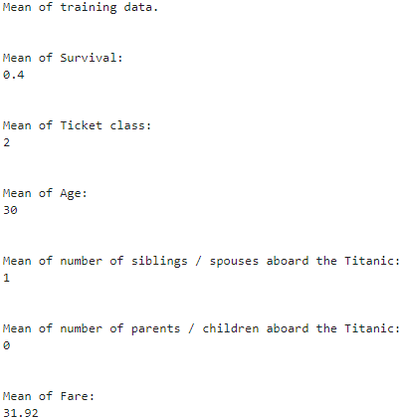

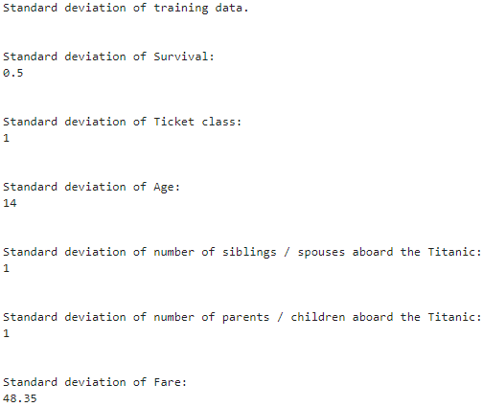
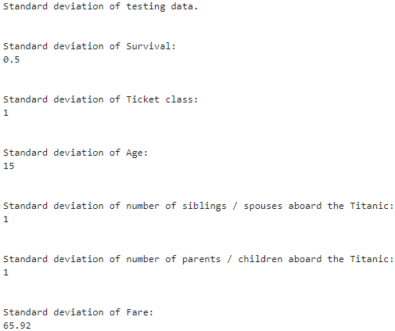
Splitting data into two sets of training and test data.
Calculating Means and Standard Deviations on both partitions of the data.
Documenting the ratios for splitting and results. (Marco)
The ratios used are 80% training and 20% testing to follow the same standard that was presented in the Data Preprocessing tutorial.
For the means, most of the attributes for the trained data were the same for the testing data which gives us the impression that both data splits coincide and are accurate.
However, both the "Mean of Age" and the "Mean of Fare" had slightly different values in their mean computations for each data split.
For the standard deviations, most of the attributes for the trained data were the same for the testing data which gives us the impression that both data splits have a low spread for those specific attributes.
However, the "Standard deviation of Fare" had different values for each data split and gives us the impression that both data splits have a high spread in the "Fare" category.

Slide 6
Comparing training and test sets and developing intuition on the meaning of the results of splitting. (Marco)
The ratios used were 80% training and 20% testing to follow the same standard that was presented in the Data Preprocessing tutorial.
The mean function was used to compute the average in the following attributes: Survived, Pclass (Ticket class), Age, SibSP (number of siblings/spouses), Parch (number of parents/children), and Fare.
The mean of the testing data and the mean of the training data is used to compute the averages of the data where applicable. Also, these means can be compared to establish an accurate connection from both data splits. Most of the attributes for the data splits were similar which gives us the impression that both data splits coincide and are accurate. However, both the "Mean of Age" and the "Mean of Fare" had slightly different values for each data split, which may result in data inaccuracies. The standard deviation function should then be used to calculate a range from the mean and determine whether a data point is "normal" or "unusual".
The standard deviation function was used to compute the data spread of the attributes above.
The standard deviation is used to compute the spread of a dataset and how far from the mean a data point is classified as "normal". Most of the attributes for the data splits were similar which gives us the impression that both data splits have a low spread for those specific attributes. However, the "Standard deviation of Fare" had different values in their standard deviation computations for each data split and gives us the impression that both data splits have a high spread in the "Fare" category. The difference in each standard deviation is expected because standard deviation is specific to each dataset and denotes how far a data point is accurate from the mean.
For example, the "Mean of Fare" for the training dataset was 31.92 and the "Standard deviation of Fare" was 48.35, and adding the two values will give us a range from the mean.
If a data point is within the range from the mean, then it considered "normal" and expected.
If a data point is outside of the range from the mean, then it is considered "unusual" and unexpected.

